Slide 1

Your Tests Are Lying To You
Kris Neuharth
kris.neuharth@gmail.com
@krisneuharth
github/krisneuharth
github.com/krisneuharth

Slide 2

Hello.
Notes:
Who Am I?
I'm Kris and I am a Python developer at a company called TrueCar.
I write web apps using Flask, primarily for the site that car dealerships interact with to price their cars and manage offers to their customers.
Shameless plug:
If the intersection of changing the automotive industry, automotive data, and Python development and testing is interesting, come talk to us. We are hiring!

Slide 3

Credit.
Notes:
Credit Where Credit Is Due
Mock is awesome!
Buy the man a drink. Seriously.

Slide 4

Drink.
Notes:
Obligatory Flask Pull and Toast!
This is liquid courage in case this turns ugly.
Moving on...

Slide 5

500+ Tests
76% Coverage
Notes:
Tests, Coverage, Statistics
Our project currently has around 500 tests, with 76% coverage.
Not too bad right?
Of course we can all do better with test coverage but I thought we were in good shape.
Until one day...

Slide 6
assert_called_once()
Notes:
Lies. Damn, Lies.
One of the other devs on the team pointed out that I had been errantly littering our code with assertions that did nothing!
What you say? That's crazy.
assert_called_once() is totally a valid assertion.

Slide 7

Notes:
Nope.
Chuck Testa.
No it isn't, but the test passes.
My tests are lying to me!

Slide 8

Notes:
So What Happened?
Am I just lazy? Was I just copy and pasting this around?
The truth is, yes.
But is that the only thing going on here?
Maybe not.
Mock provides a powerful way to mock out methods and methods on objects
Should I even be able to make these assertions that don't exist?
Let's find out.

Slide 9
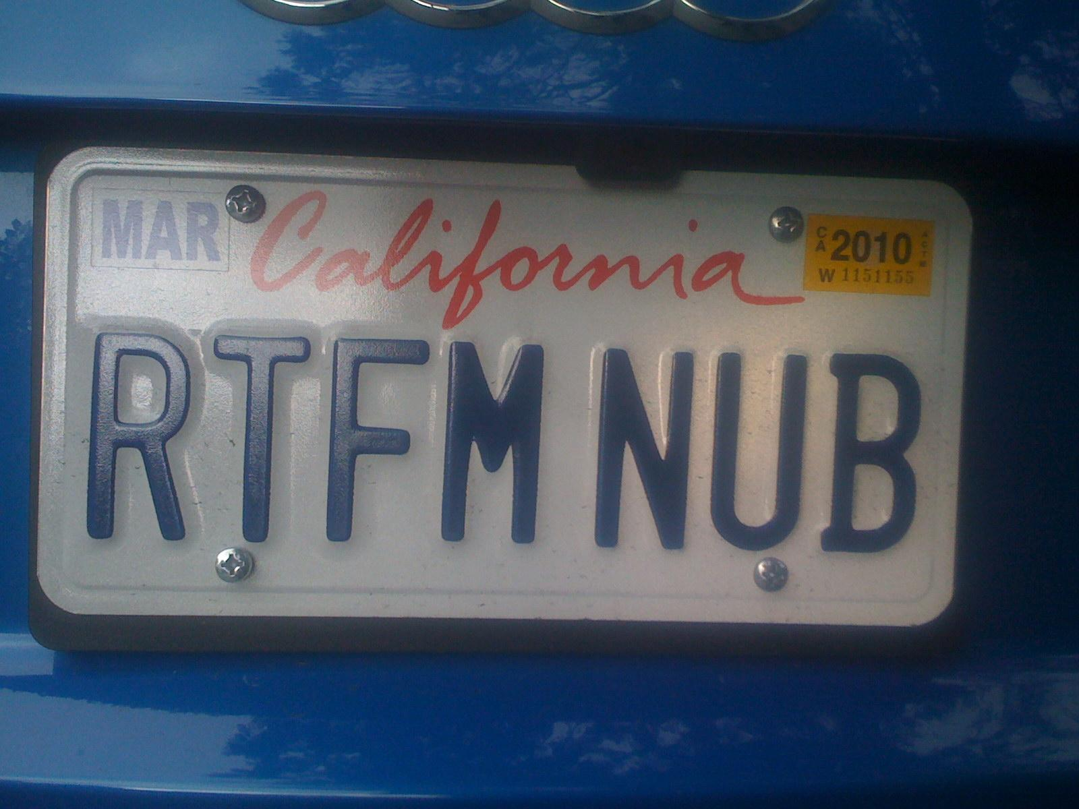
Notes:
RTFM
Thankfully this sort of problem is well documented and is solved with something called a "spec."
When a spec is specified, Mock will raise exceptions when you try to mock methods that do not exist.
Awesome.
Simple fix, use a spec.
Also, worth mentioning but I don't have time to get into:
"spec_set" - does something similar, it prevents you from setting properties of the mocked object that do not exist.
"autospec" - only access attributes on the mock that exist on the real class
This problem is actually described in detail:
TODO:

Slide 10
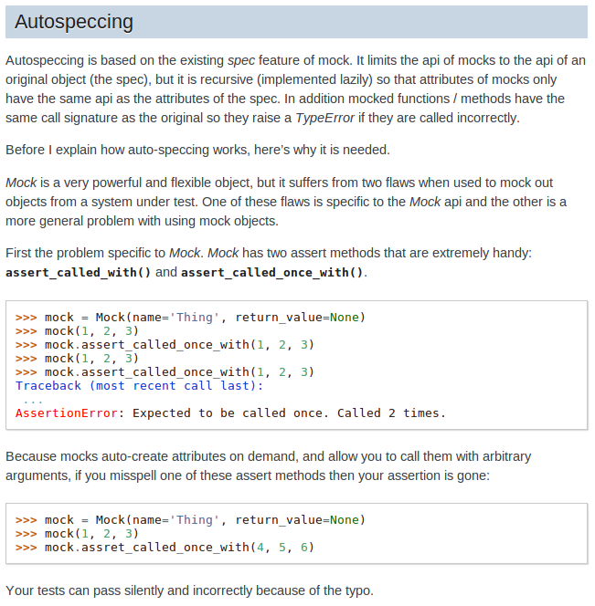
http://www.voidspace.org.uk/python/mock/helpers.html#autospeccing

Slide 11
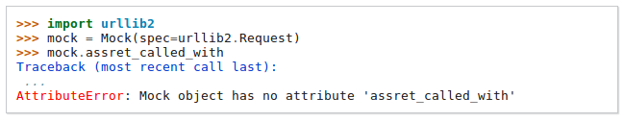

Slide 12

Notes:
But Why Was I Making This Mistake In the First Place?
I have read the M!
I think what happened is that the more I used Mock and the Python unittest library, the less I looked up the assertions in the documentation.
I had gotten lazy and started fusing various assertions together from memory.
I had made the incorrect assumption that there should be symmetry in the Mock assertion APIs.
My brain had created symmetry where there was none.

Slide 13

Extend
Notes:
Extending Mock
From the Mock documentation we can clearly see:
assert_called_with
assert_called_once_with
assert_any_call
assert_has_calls
And that what I was doing:
assert_called_once
is wrong.
But what if I wanted to add it? I will need to extend Mock.
Michael provides a blog post on his site to this topic:
TODO: http://www.voidspace.org.uk/python/weblog/arch_d7_2011_07_16.shtml#e1221
It seems easy enough.

Slide 14
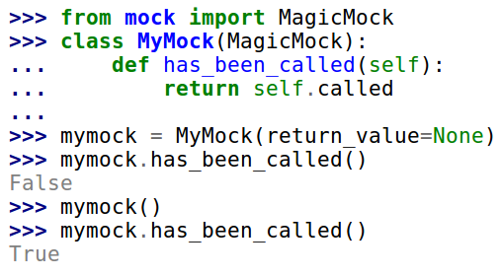
http://www.voidspace.org.uk/python/weblog/arch_d7_2011_07_16.shtml#e1221

Slide 15

mock
Notes:
Enter 'SmartMock'
SmartMock is certainly not a criticism that MagicMock or Mock are dumb.
More that it helps me be smarter.
<show the code>
<show how the code plugs into patch.object>
I wasn't sure how to get SmartMock and Knave to both have spec protect me, so I created a hybrid object called TestKnave. This may be wrong, but seems to work?
I'd be happy to hear comments about this later.

Slide 16
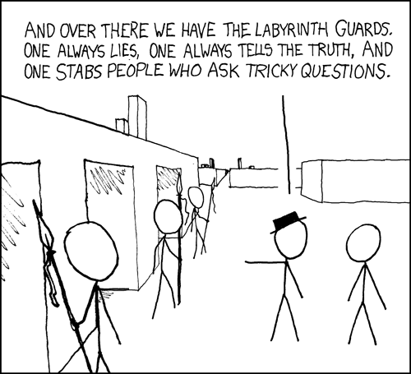
Notes:
Contrived Code To Test
Who doesn't love contrived code examples?
<run knights and knaves game>
<run the tests>

Slide 17

Excellent.
Notes:
Excellent.
Our tests run.
The SmartMock assertions are being used.
While most of the tests pass, the two that do not, should not.
They are asserting nonsensical things on their mocked object.
This is the way it should be.

Slide 18
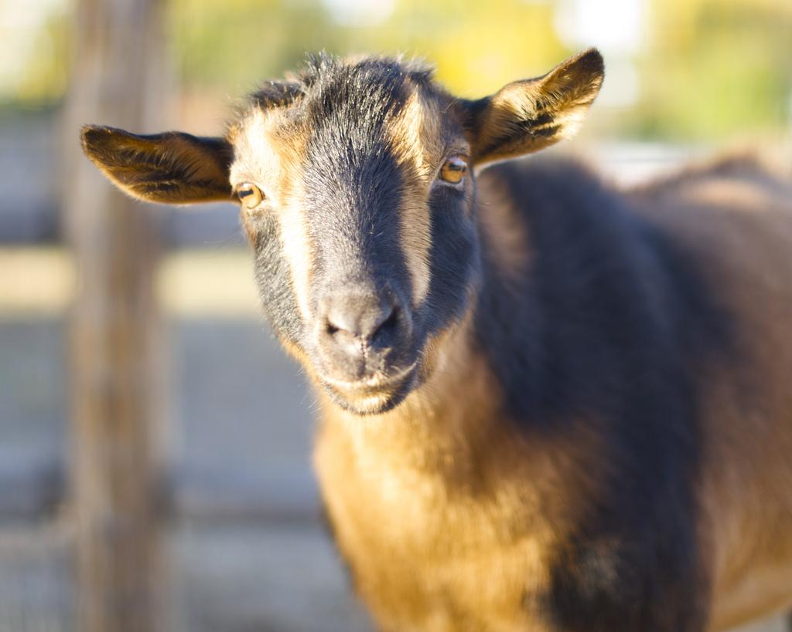
tl;dr
Notes:
tl;dr
If there is anything to learn from this talk:
Thanks Michael!
RTFM, seriously.
Use spec and similar
Extend Mock for your own purposes
Scotch
Obligatory code and slides are on github statement.

